Slide 1
Pointer in C-Language

Slide 2
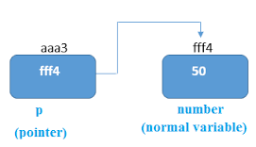
Definition
A pointer is a variable which contains the address in memory of another variable

Slide 3
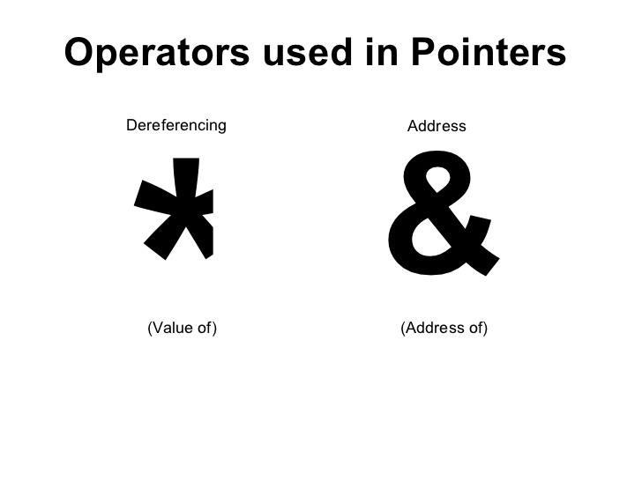
We can have a pointer to any variable type.
The reference operator & gives the ``address of a variable''. Or Reference Operator
The indirection or dereference operator * gives the ``value at the address of”

Slide 4
C uses pointers a lot. Why?:
It is the only way to express some computations.
It produces compact and efficient code.
It provides a very powerful tool.

Slide 5
C uses pointers explicitly with:
Arrays,
Structures,
Functions.

Slide 6
How to declare a pointer?
data_type *pointer_variable_name;
int *p;
Above statement defines, p as pointer variable of type int.

Slide 7
Example
int main(){
int* p;
int c;
c=2;
printf("Address of c:%u\n",&c);
printf("Value of c:%d\n\n",c);
p=&c;
printf("Address of c:%u\n",p);
printf("Content of pointer p:%d\n\n",*p);
return 0;
}
Address of c: 2616781
Value of c: 2
Address of c: 2616781
Content of pointer p: 2

Slide 8
char ch = 'S';
int a = 7;
float f =3.118981;
char *p;
int *t;
float *i;
clrscr();
p = &ch;
printf("value in ch = %c\n",ch);
printf("Address of ch = %u\n",&ch);
printf("Address of ch = %u\n",p);
printf("Value at the address of %c\n\n\n",*p);
t = &a;
printf("value in a = %d\n",a);
printf("Address of a = %u\n",&a);
printf("Address of a = %u\n",t);
printf("Value at the address of %d\n\n\n",*t);
i = &f;
printf("value in f = %f\n",f);
printf("Address of f = %u\n",&f);
printf("Address of f = %u\n",i);
printf("Value at the address of %f\n",*i);
getch();
return 0;
}

Slide 9
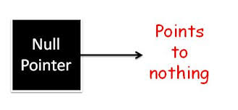
NULL Pointers
A pointer that is assigned NULL is called a null pointer.
good practice to assign a NULL value to a pointer variable in case you do not have an exact address to be assigned.
done at the time of variable declaration.
#include<stdio.h>
int main () {
int *ptr = NULL;
printf("The value of ptr is : %x\n", ptr );
return 0;
}
Output: The value of ptr is 0

Slide 10
In most of the operating systems, programs are not permitted to access memory at address 0 because that memory is reserved by the operating system.
However, the memory address 0 has special significance
it signals that the pointer is not intended to point to an accessible memory location.
But by convention, if a pointer contains the null (zero) value, it is assumed to point to nothing.

Slide 11
Pointer Arithmetic
can perform arithmetic operations on a pointer
four arithmetic operators can be used on pointers:
++,
--,
+ and
-

Slide 12
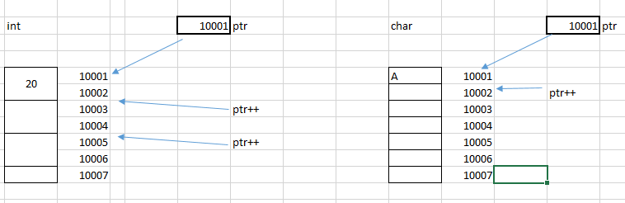
each time ptr is incremented, it will point to the next integer location which is 4 bytes next to the current location.
This operation will move the pointer to the next memory location without impacting the actual value at the memory location.
If ptr points to a character whose address is 1000, then the above operation will point to the location 1001 because the next character will be available at 1001.

Slide 13
int main()
{
char ch = 'A';
int a = 20;
char *t;
int *p;
clrscr();
p=&a;
printf("Address of a = %u \n",p);
p++;
printf("Address of a = %u \n",p);
p= p + 1;
printf("Address of a = %u \n\n\n",p);
t = &ch;
printf("Address of ch = %u \n",t);
t++;
printf("Address of ch = %u \n",t);
t = t + 1;
printf("Address of ch = %u \n",t);
getch();
return 0;
}

Slide 14
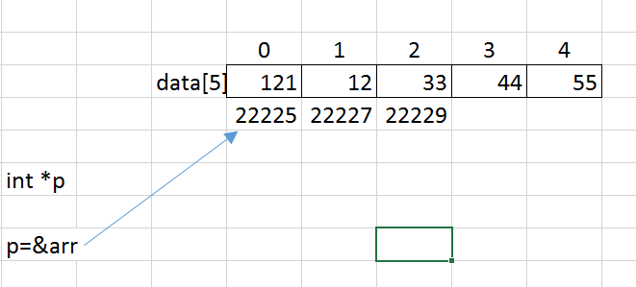
Array and Pointers
int main()
{
int a;
int data[5] = {121,131,141,156,111};
int *p;
clrscr();
p=&data; //or p=&arr[0]
for(a=0;a<=4;a++)
{
printf("%u\n",p);
p++;
}
getch();
return 0;
}

Slide 15
Array and Pointers
int main()
{
int a;
int data[5];
int *p;
clrscr();
p=&data;
for(a=0;a<=4;a++)
{
printf("Enter value:");
scanf("%d",&data[a]);
}
printf("\n\n Memory location\n\n");
for(a=0;a<=4;a++)
{
printf("memory location at %d = %u\n",a,p);
p++;
}
getch();
return 0;
}

Slide 16
Accessing Array members using Pointer
int main()
{
int data[5], i;
printf("Enter elements: \n\n");
clrscr();
for(i = 0; i < 5; ++i)
{
scanf("%d", data + i);
}
printf("You entered: \n");
for(i = 0; i < 5; ++i)
{
printf("%d\n", *(data + i));
}
return 0;
}

Slide 17

Pointer to pointer
int main () {
int var;
int *ptr;
int **pptr;
var = 3000;
/* take the address of var */
ptr = &var;
/* take the address of ptr using address of operator & */
pptr = &ptr;
/* take the value using pptr */
printf("Value of var = %d\n", var );
printf("Value available at *ptr = %d\n", *ptr );
printf("Value available at **pptr = %d\n", **pptr);
return 0;
}
Its is a pointer variable that contains the adress of another pointer variable

Slide 18
Pointer as Function parameter
Pointer in function parameter list is used to hold address of argument passed during function call.
This is also known as call by reference.
When a function is called by reference any change made to the reference variable will effect the original variable.

Slide 19
Sending the values of the arguments- ‘Call by Value’.
main( )
{
int a = 10, b = 20 ;
swapv ( a, b ) ;
printf ( "\na = %d b = %d", a, b ) ;
}
swapv ( int x, int y )
{
int t ;
t = x ;
x = y ;
y = t ;
printf ( "\nx = %d y = %d", x, y ) ;
}
Output:
========
x = 20 y = 10
a = 10 b = 20
In the first method the ‘value’ of each of the actual arguments in
the calling function is copied into corresponding formal arguments
of the called function.
With this method the changes made to the formal arguments in the called function have no effect on the values of actual arguments in the calling function.

Slide 20
Sending the addresses of the arguments - call by reference
main( )
{
int a = 10, b = 20 ;
swapr ( &a, &b ) ;
printf ( "\na = %d b = %d", a, b ) ;
}
swapr( int *x, int *y )
{
int t ;
t = *x ;
*x = *y ;
*y = t ;
printf ( "\nx = %d y = %d\n\n", x, y ) ;
}
Output:
a = 20 b = 10
addresses of actual arguments in the calling function are copied into formal arguments of the called function.
This means that using these addresses we would have an access to the actual arguments and hence we would be able to manipulate them.

Slide 21
Pointer and structure.
Structure can be created and accessed using ”Pointer”.
A pointer variable of a structure can be created
struct name {
member1;
member2;
.
.
};
int main()
{
struct name *ptr;
}

Slide 22
Accessing structure's member through pointer
A structure's member can be accessed through pointer in two ways:
Referencing pointer to another address to access memory
Using dynamic memory allocation

Slide 23
Referencing pointer to another address to access the memory
#include <stdio.h>
typedef struct person
{
int age;
float weight;
};
int main()
{
struct person *personPtr, person1;
personPtr = &person1; // Referencing pointer to memory address of person1
printf("Enter integer: ");
scanf("%d",&(*personPtr).age);
printf("Enter number: ");
scanf("%f",&(*personPtr).weight);
printf("Displaying: ");
printf("%d%f",(*personPtr).age,(*personPtr).weight);
return 0;
}
The pointer variable of type struct person is referenced to the address of person1.
Then, only the structure member through pointer can can accessed.

Slide 24
Using -> operator to access structure pointer member
(*personPtr).age is same as personPtr->age
(*personPtr).weight is same as personPtr->weight

